Slide 1
Human Emotion Detection using EEG Signals
Team 02
Ajay Wadki 01FE16BCS017
Akshay Hampiholi 01FE16BCS020
Mahim Patil 01FE16BCS097
Karthik R D 01FE16BCS089

Slide 2
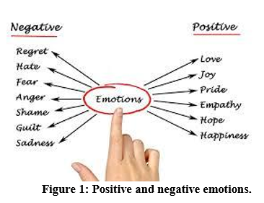
Introduction
Human Emotions:
Human emotion is a complex phenomenon which comes from human brain and is associated with wide variety of human feelings thoughts and behaviours .Hence they affect our ability to act rationally in cases such as decision making, perception and human intelligence.

Slide 3
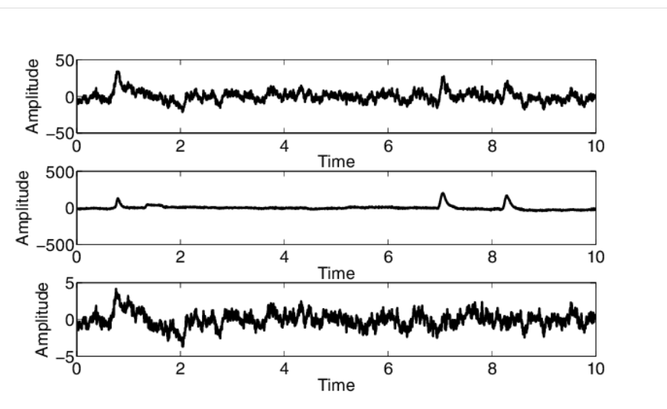
Continued…
EEG
Electroencephalography (E.E.G) is a brain imaging technique which records the electrical activity of the brain using electrodes placed on the scalp.

Slide 4
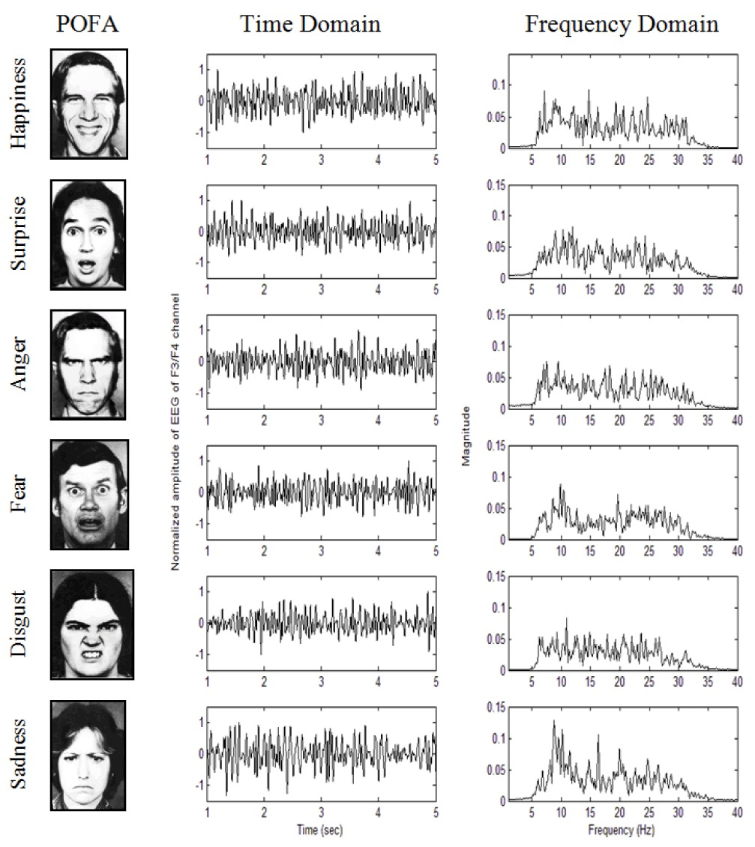
EEG Signals in detecting Human Emotions
EEG Signals can take hundreds to thousands of snapshots of electrical activity from multiple electrodes within a single second. This renders EEG an ideal technology to study the precise time-course of cognitive and emotional processing underlying behavior

Slide 5
Motivation
Humans react differently to different situations and these changes in emotions will help doctors to diagonise any disease and the responses to medications.
Study of Human Emotions can be used for Mind Implementation of Robots.
It gives clear idea about customer satisfaction in e-learning and marketing
It helps in analysis of behaviour of criminals in investigations.

Slide 6
Literature Survey
Author | Issue Considered | Method | Remark
Keshav Murthy etl | Behaviour Detection using EEG | Feature based approach was followed .Synchronisation Likehood between lobes was stored in SL Matrix and used to represent state of brain.The Time Series of weight vectors corresponds to principal components of SL matrix at each time point is used to classify. | Noise Removal is a challenge to be addressed for better accuracy.
Prashant Lahane | Human Emotion Detection | Teager Keager Energy operator is new approach of energy measure.It is characteristic of time and can track changes in signal.It is used as new feature and the extracted features are categorized by classifier. | T.K.E Operator is simple with fast execution.

Slide 7
Continued…
Author | Issue Considered | Method | Remark
Thejaswini S etc | EEG signal Based Emotion Detection | The models developed for detecting emotion states are preferably supervised algorithms. the pre-processed data are analyzed using different features in frequency and time domain. A supervised machine learning model is developed to identify the emotion states into 4 classes. | Some more features can be added to increase the classifier rate. A robust model can be developed to classify inner emotions for different databases
Manar Hosny etc | Classification of Human Emotions from EEG Signal using Deep Neural Network | The models developed for EEG signal to the detection of four emotion states (Excitement, Meditation, Boredom, and Frustration) using DNN classification and Random Forest classifier. | The DNN classifier performs best when the dataset is large.

